Slide 1
Project _10_AWS: Custom OCR Solution Using YOLOv3 and Tesseract Subtitle: Combining Object Detection and OCR for Lab Report Analysis Presented by: Hema M.

Slide 2
Project Overview Objective: Build a custom OCR solution to extract specific information from lab reports (test names, values, units, reference ranges). Goal: Convert lab report data into structured, editable formats. Key Technologies: YOLOv3, Tesseract, OpenCV, Fuzzy Matching, Flask, AWS

Slide 3
Key Workflow Breakdown
Object Detection: YOLOv3 detects regions of interest (test names, values).
Image Preprocessing: Resize, grayscale, and apply filters for better OCR accuracy.
Text Extraction: Tesseract processes the preprocessed images to extract text.
Result Storage: The extracted data is saved in CSV format.

Slide 4

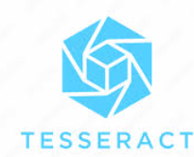


Technologies Used
YOLOv3: For identifying specific regions in lab reports.
Tesseract: For OCR text extraction.
OpenCV: For image preprocessing.
Fuzzy Matching: For enhancing detection accuracy.

Slide 5
YOLOv3 (You Only Look Once, Version 3):
Object Detection Algorithm: YOLOv3 is a third-generation real-time object detection system that builds on YOLOv2's architecture for enhanced accuracy and speed.
Why it's Used: It is widely used due to its real-time detection, multi-scale predictions, and ability to detect small objects more accurately.
Key Features:
Real-Time Detection: Capable of processing images at high speed, making it suitable for applications where quick response is crucial.
Improved Accuracy: Uses multi-scale detection, meaning it predicts objects at three different scales, making it better at detecting small objects.
Darknet-53 Backbone: YOLOv3 employs a more advanced convolutional neural network (CNN) called Darknet-53, which improves feature extraction.
Bounding Boxes with Confidence Scores: YOLOv3 assigns confidence scores to each bounding box, enhancing detection precision.

Slide 6
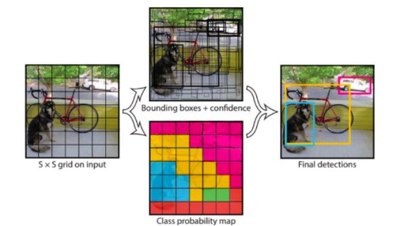
Yolov3 object detection process
Step1: The image is divided into a grid.
Step 2: Each cell predicts bounding boxes and confidence scores.
Step 3: Class probabilities are calculated for each bounding box.
Step 4: Final bounding boxes are determined, and overlapping ones are suppressed using NMS.
In the example image:
The grid cells predicted bounding boxes for the dog, bicycle, and car.
Confidence scores and class probabilities were used to decide the final detections.
Each detected object (dog, bike, car) is outlined with a colored box

Slide 7
Key Steps of Image Processing
Step 1: Load lab report image using OpenCV.
Step 2: Apply YOLOv3 for bounding box detection.
Step 3: Use Tesseract for text extraction.
Step 4: Perform fuzzy matching for detected words (test names, units).
Data Output and Visualization
Output: Extracted information is saved into CSV files (test name, value, unit, reference range).
Visualization: Final processed image saved with bounding boxes for verification.

Slide 8
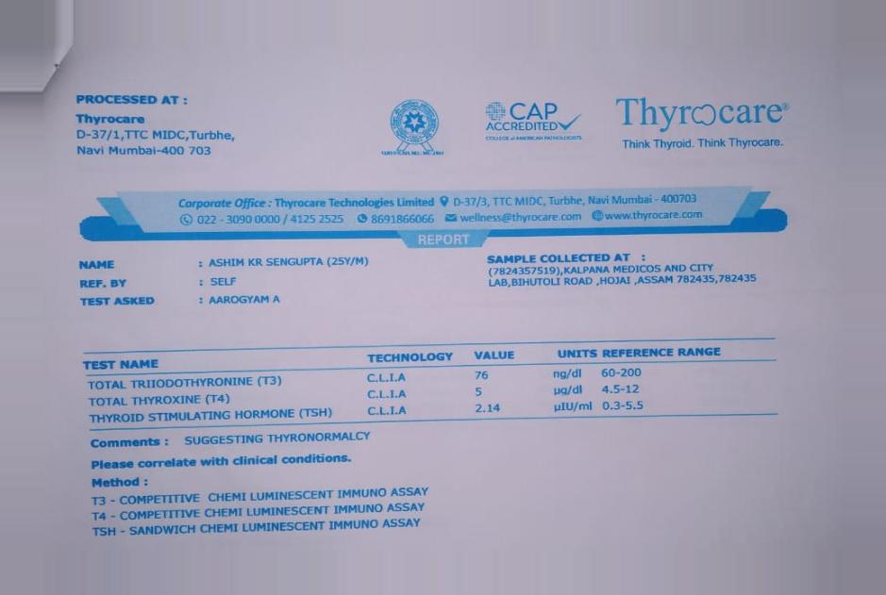
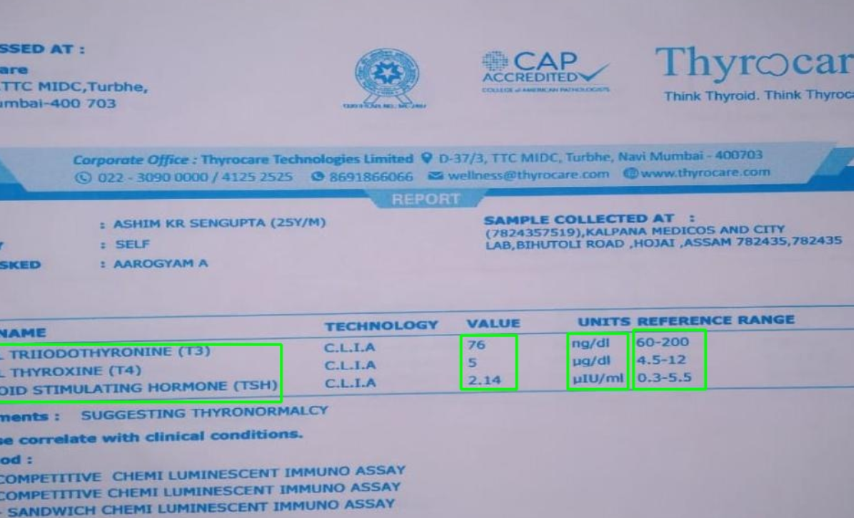
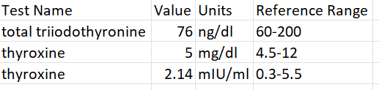
Step 1: Load lab report image using OpenCV.
Step 2: Apply YOLOv3 for bounding box detection.
Step 3: Use Tesseract for text extraction.
Step 4: Perform fuzzy matching for detected words (test names, units).

Slide 9
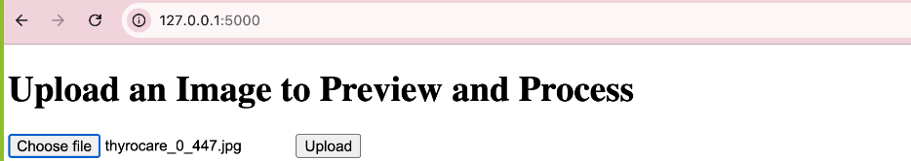
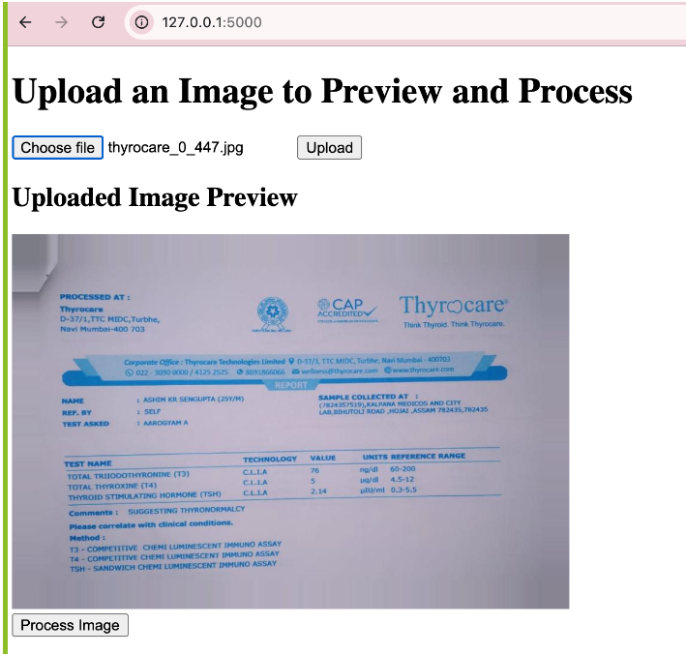
FLASK INPUT

Slide 10
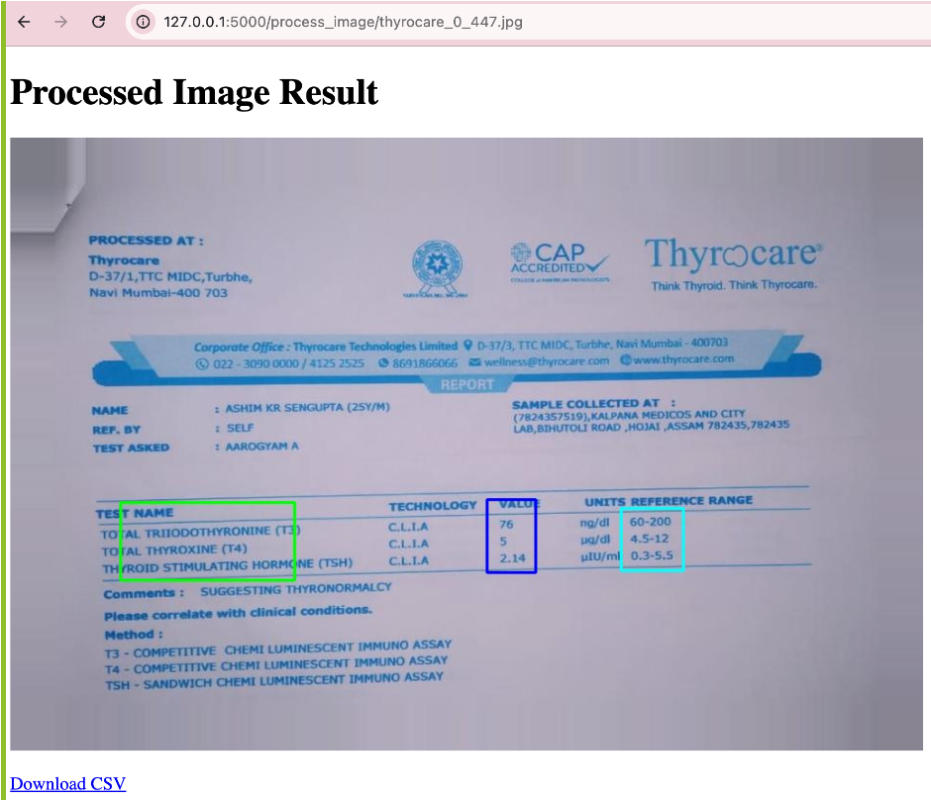
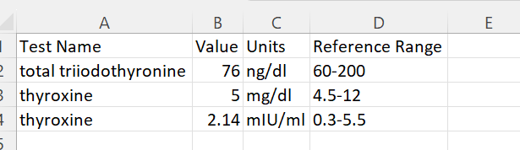
FLASK OUTPUT

Slide 11
Results and Conclusion
Results: Successfully extracted and categorized data from lab reports.
Exported results as CSV.
Visualized regions of interest in processed images.
Conclusion:
By leveraging YOLOv3 and Tesseract, the project successfully achieved its objective of detecting and extracting relevant sections of lab reports. The implementation of Flask made it easy to deploy and run the solution locally, The system accurately identified key fields, processed them, and delivered editable results in CSV format, providing a practical and efficient method for digitizing lab reports.

Slide 12
THANK YOU

